Slide 1
Swift language
Array

Slide 2
Objective
What is an array
What are applications of an array
How to define an array
How to initialize an array
How to access elements of an array
Search algorithm (sequential and binary)
Sort algorithm

Slide 3
What is an array
An array is a special variable having one name, but storing a list of data items, with each item being directly accessible
Arrays allow us to store elements of single data type contiguously in memory
Each item in an array is known as an element
Each element is associated with an index or location
We can access any element by indexing into the array

Slide 4
What is an array
An array is simply a container that can hold multiple data (values) of a data type in an ordered list, i.e. you get the elements in the same order as you defined the items in the array
An array can store values of any data type e.g. Int, String, class etc.

Slide 5
Array?
You use an array to hold a list of items of the same type, keeping them in order
Items in an array don’t have to be unique

Slide 6
Index?
The index is the numbered position of an item in an ordered collection
Index of the first item in an array is always 0
Index of the last item in an array will equal the total number of items minus one

Slide 7
How to define empty array
var intArray = [Int]()
var doubleArray = [Double]()
var stringArray = [String]()
var characterArray = [Character]()

Slide 8
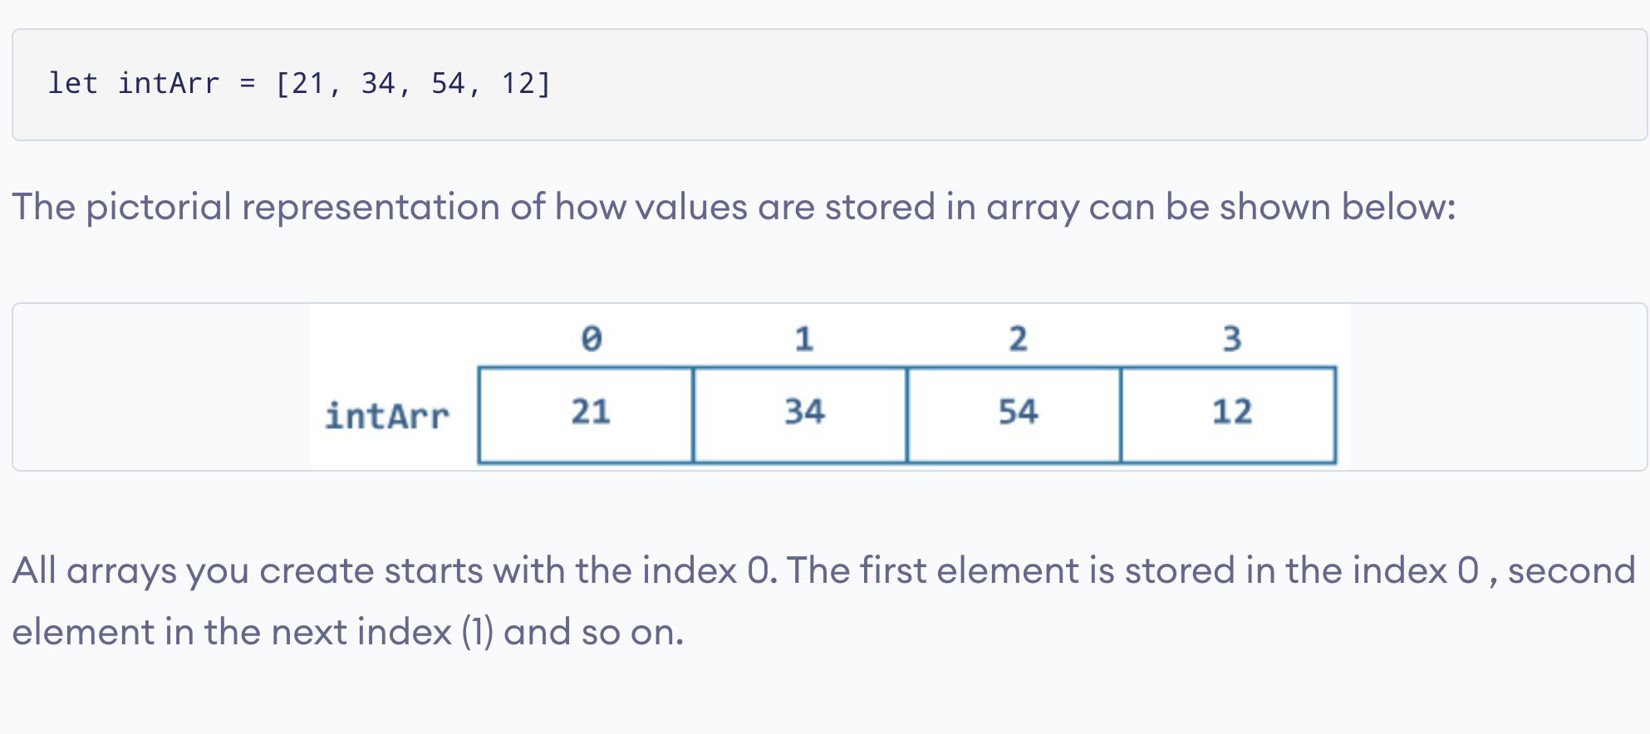
How to define and initialize array

Slide 9
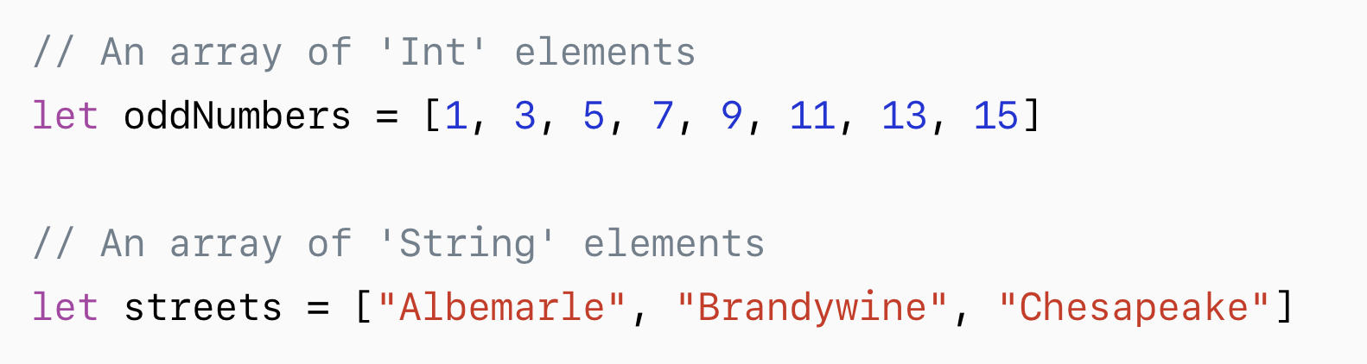
How to define and initialize array

Slide 10
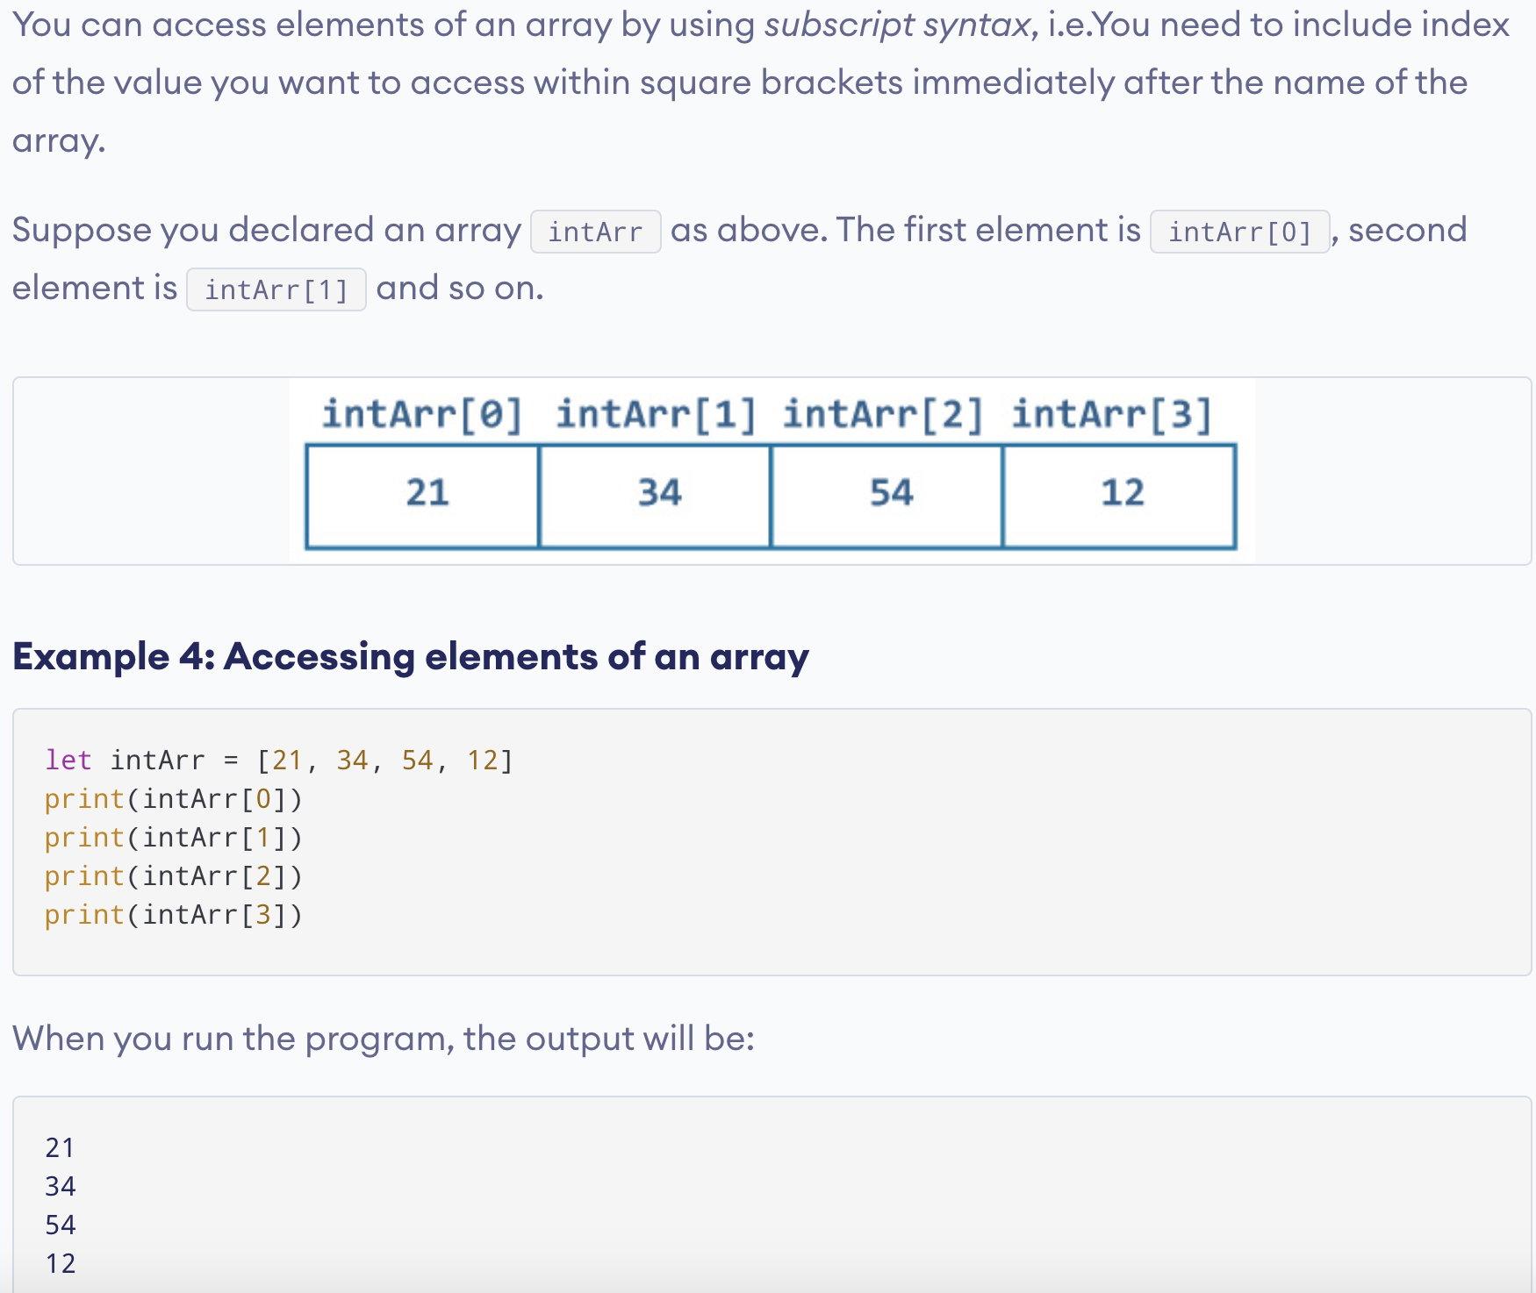
How to access array elements in Swift?

Slide 11
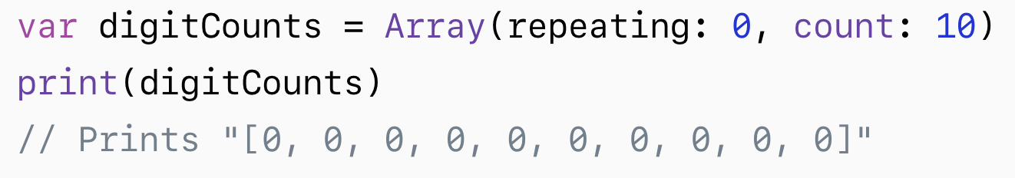
How to define and initialize array

Slide 12
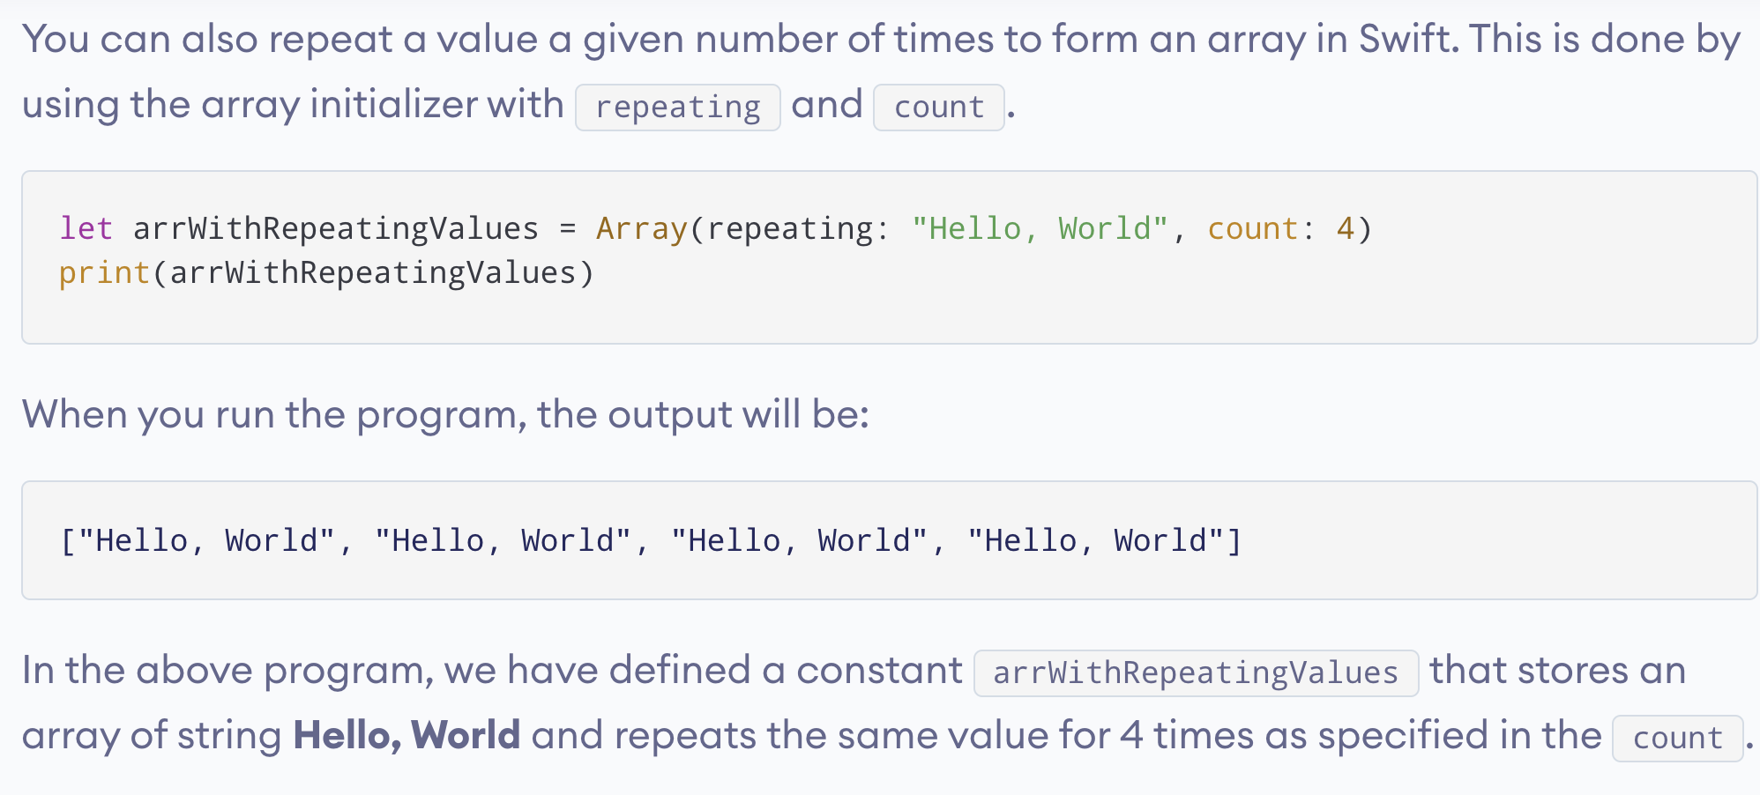
How to define and initialize array

Slide 13
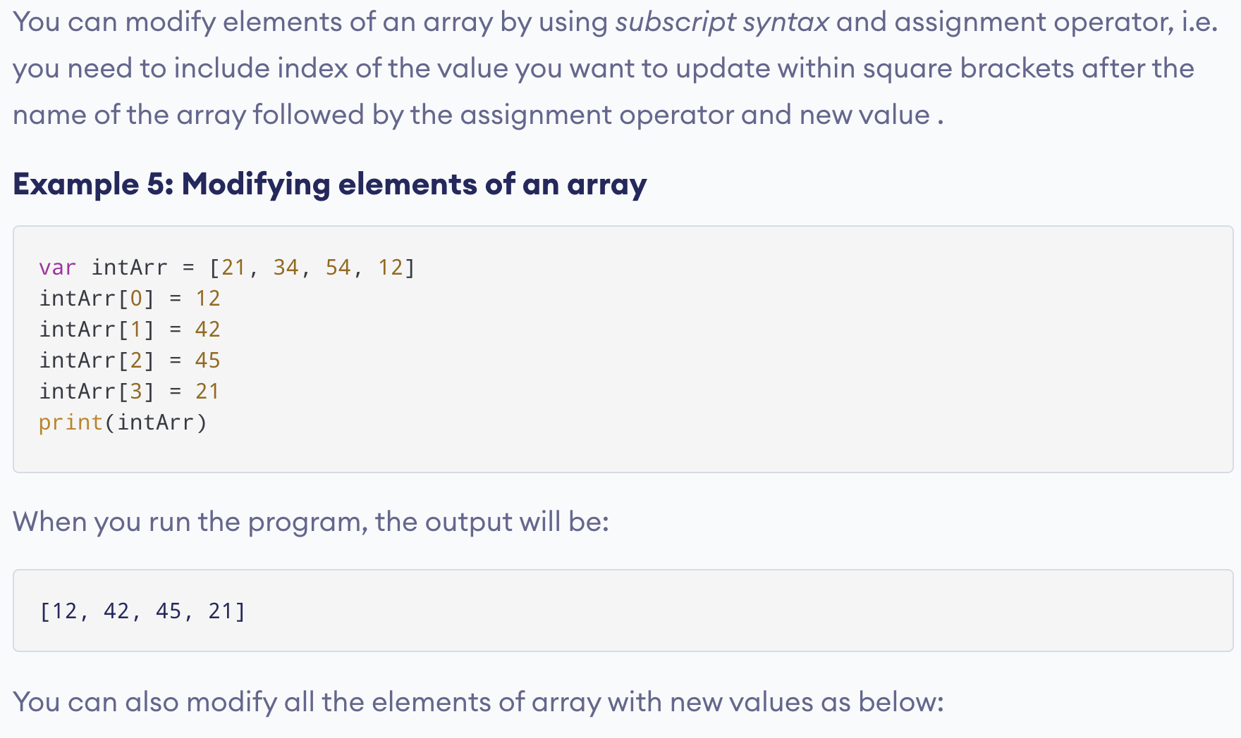
How to modify/add array elements in Swift?

Slide 14
How to add new element to an integer array
var intArray = [Int]()
intArray.append(10);intArray.append(20);intArray.append(30);
for index in 0 ... intArray.count - 1
{
print(intArray[index])
}

Slide 15
How to add new element to an double array
var doubleArray = [Double]()
doubleArray.append(10.5);doubleArray.append(20.5);doubleArray.append(30);
for index in 0 ... doubleArray.count - 1
{
print(doubleArray[index])
}

Slide 16
How to add new element to an string array
stringArray.append("Tom");stringArray.append("Alex");stringArray.append("Dianne");
for index in 0 ... stringArray.count - 1
{
print(stringArray[index])
}

Slide 17
How to add new element to an character array
var characterArray = [Character]()
characterArray.append("T");characterArray.append("A");characterArray.append("D")
for index in 0 ... characterArray.count - 1
{
print(characterArray[index])
}

Slide 18
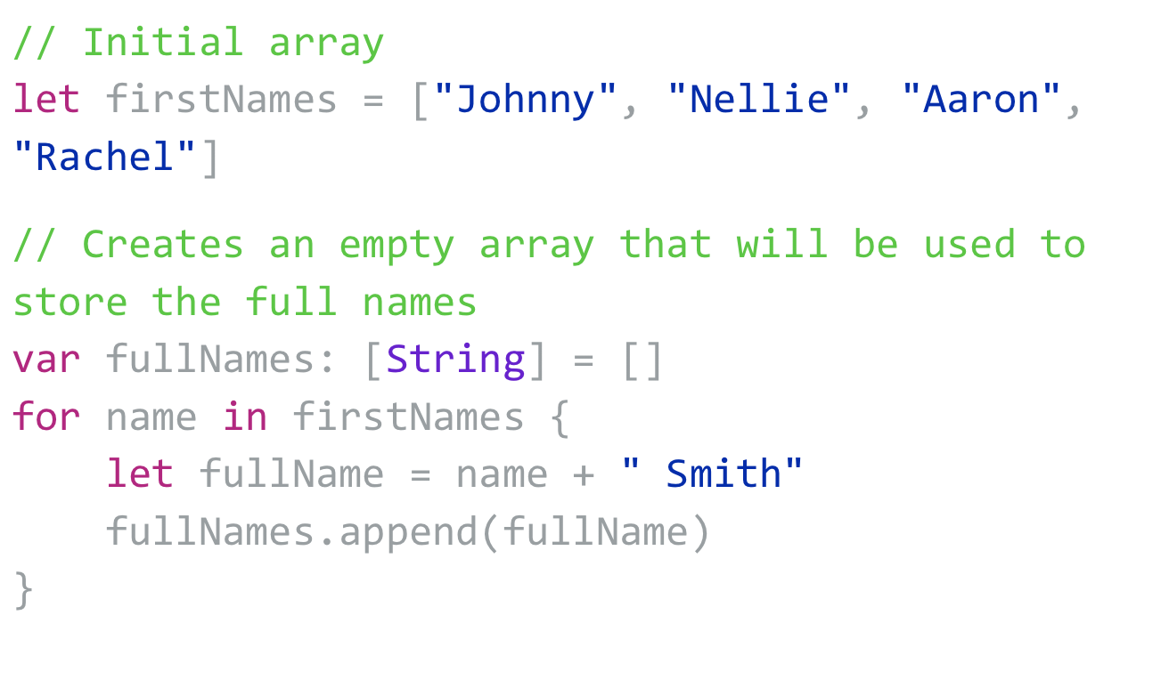
Array example

Slide 19
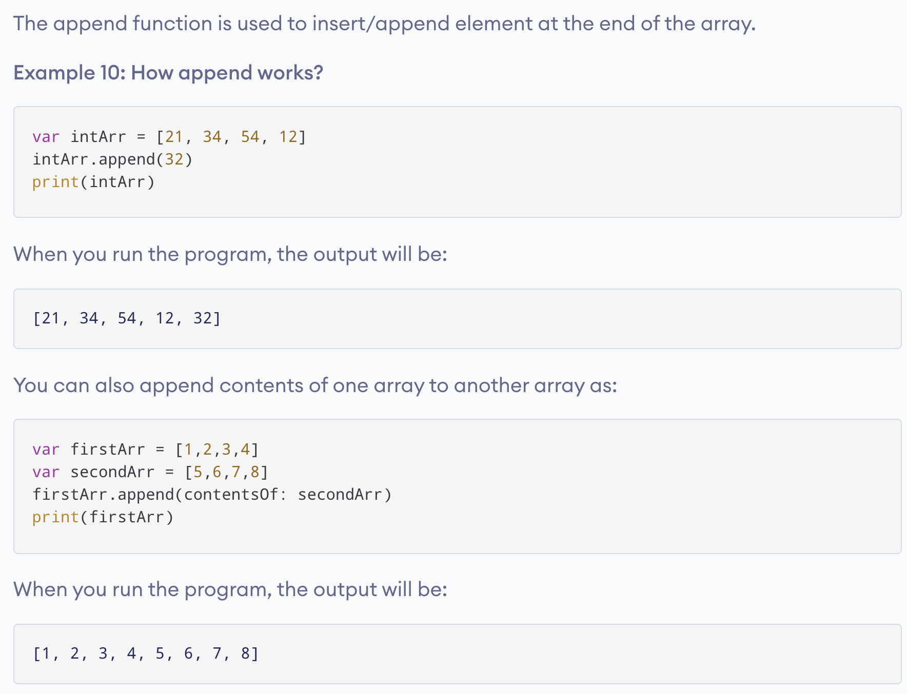
Some helpful built in Array functions & properties: append

Slide 20
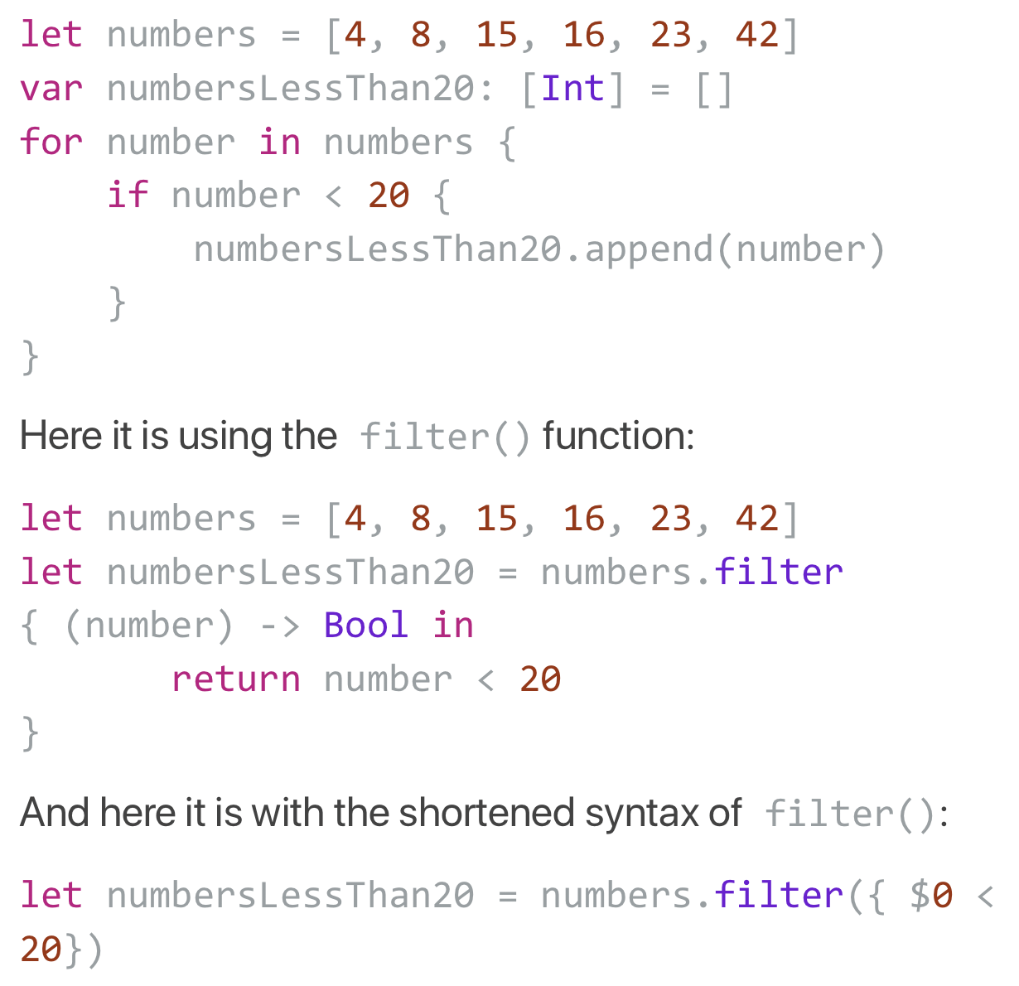
Array example

Slide 21
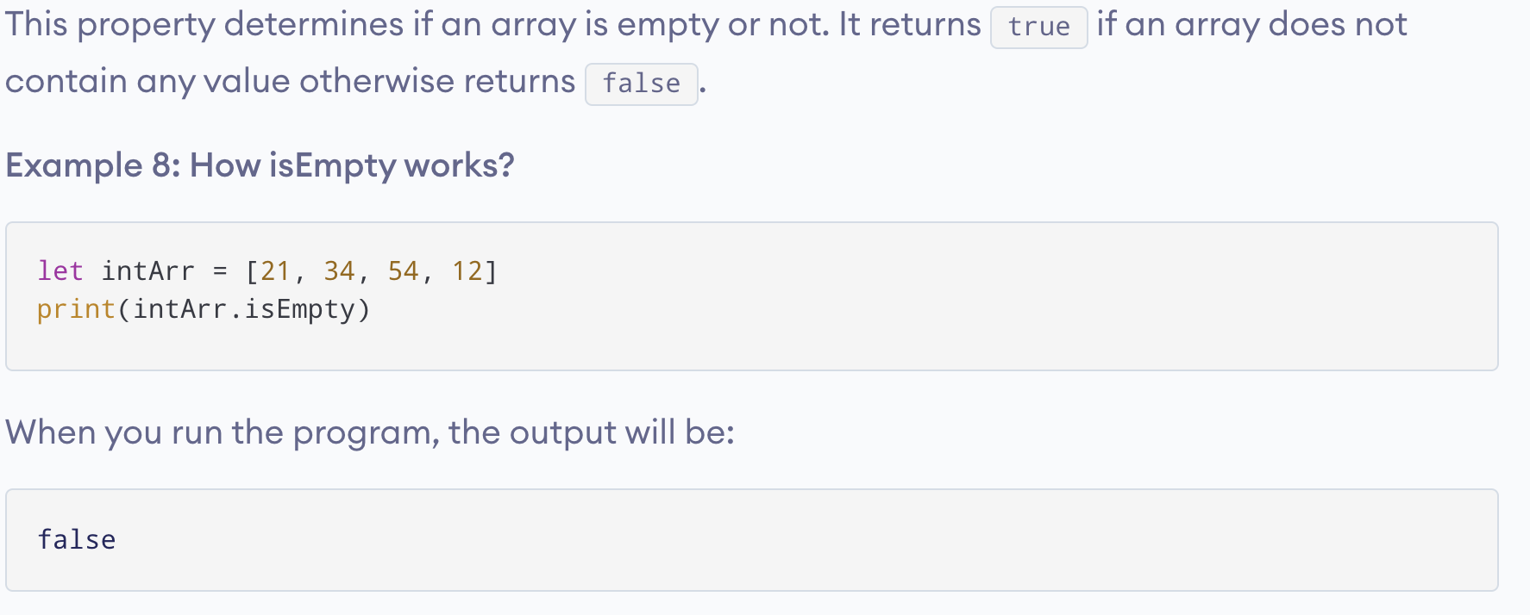
Some helpful built in Array functions & properties: isEmpty

Slide 22
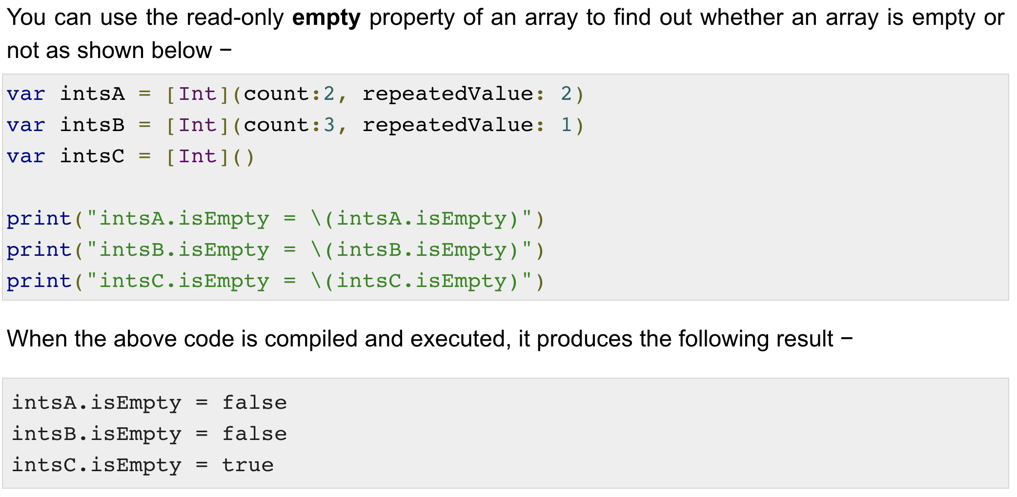
Some helpful built in Array functions & properties: isEmpty

Slide 23
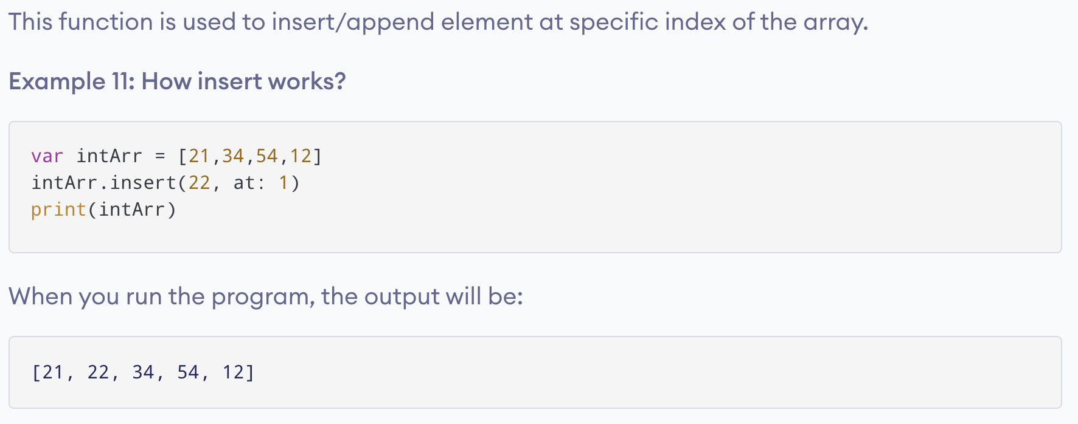
Some helpful built in Array functions & properties: insert

Slide 24
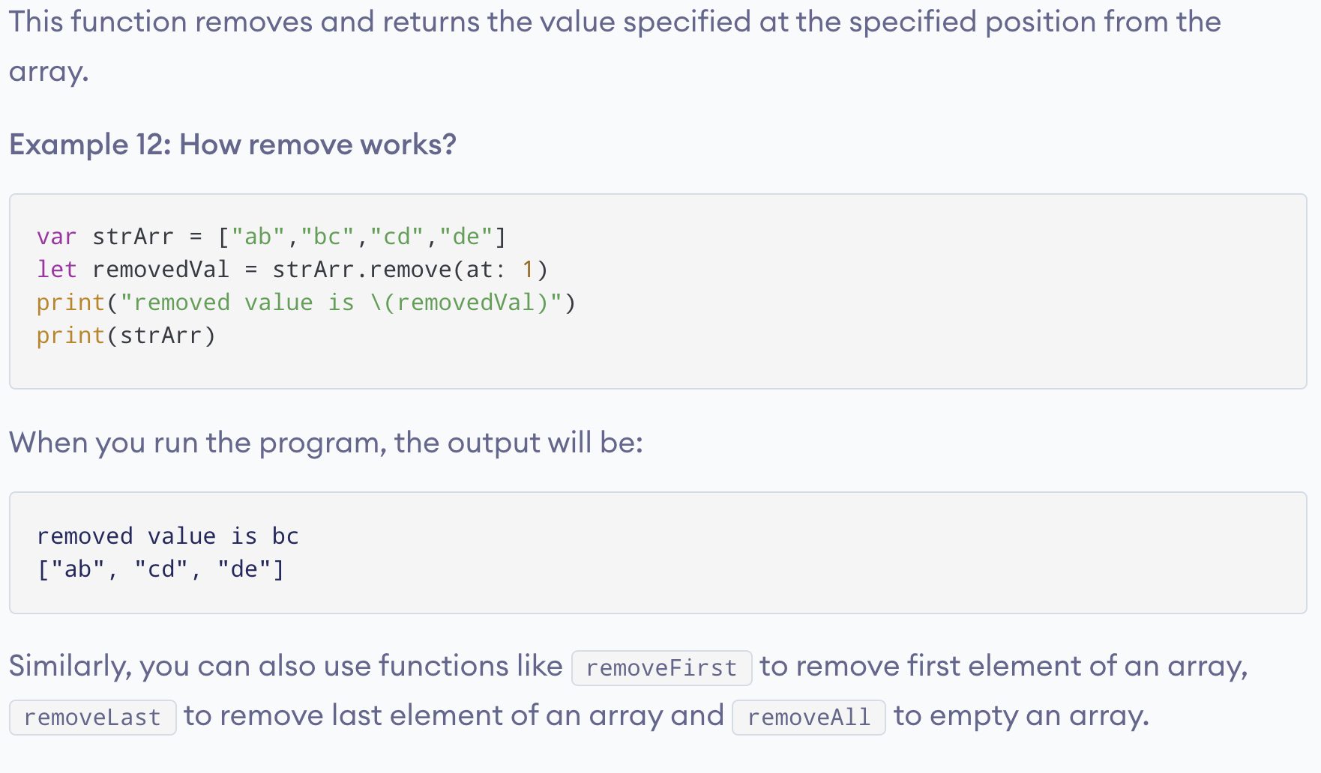
Some helpful built in Array functions & properties: remove

Slide 25
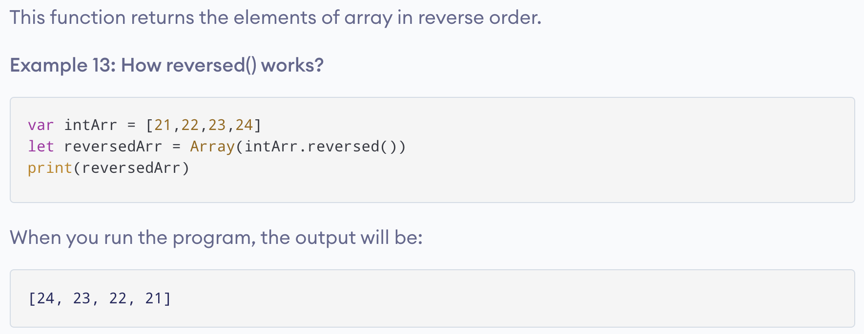
Some helpful built in Array functions & properties: reversed

Slide 26
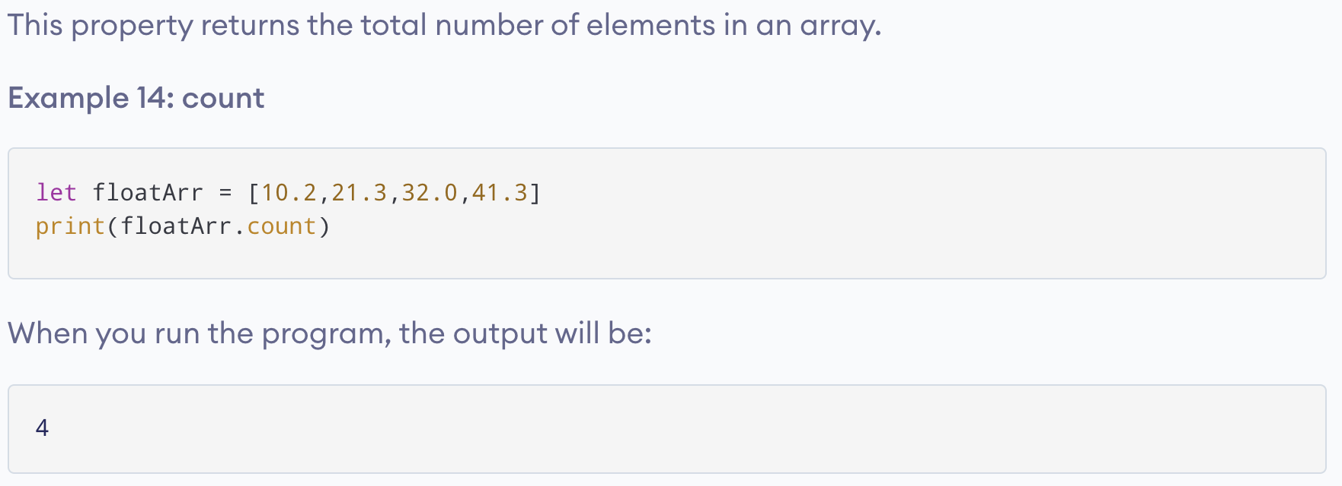
Some helpful built in Array functions & properties: count

Slide 27
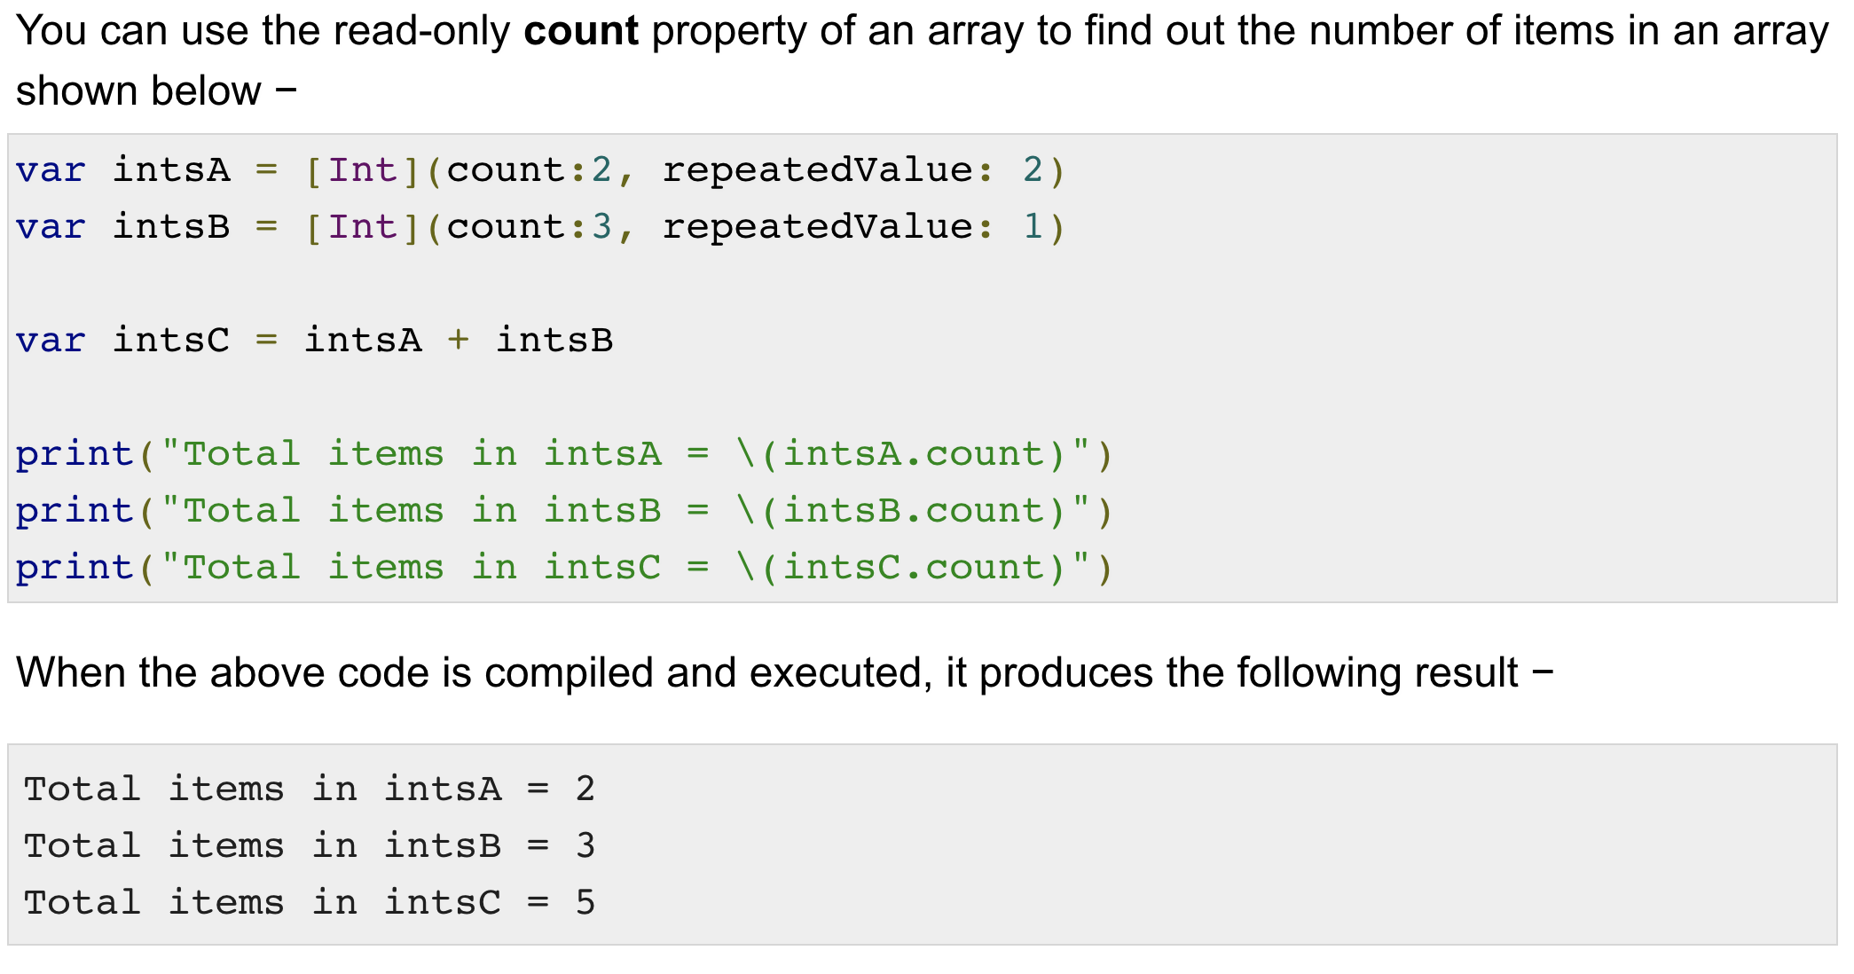
The count Property

Slide 28
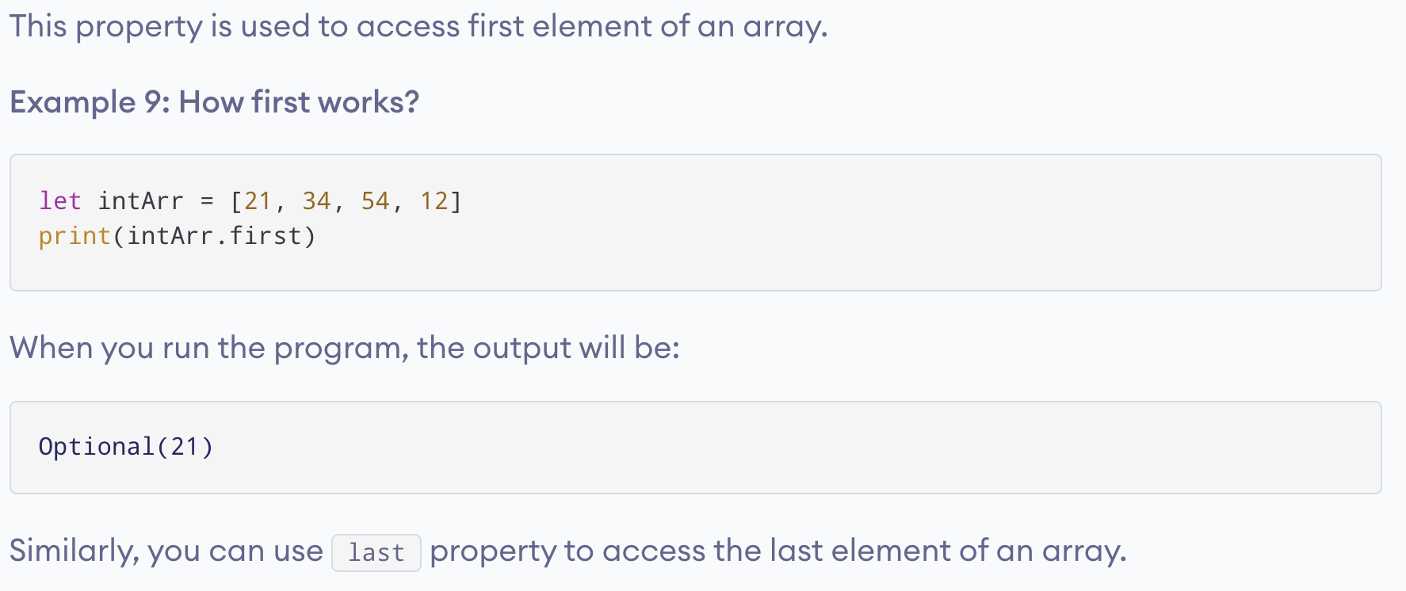
Some helpful built in Array functions & properties: first

Slide 29
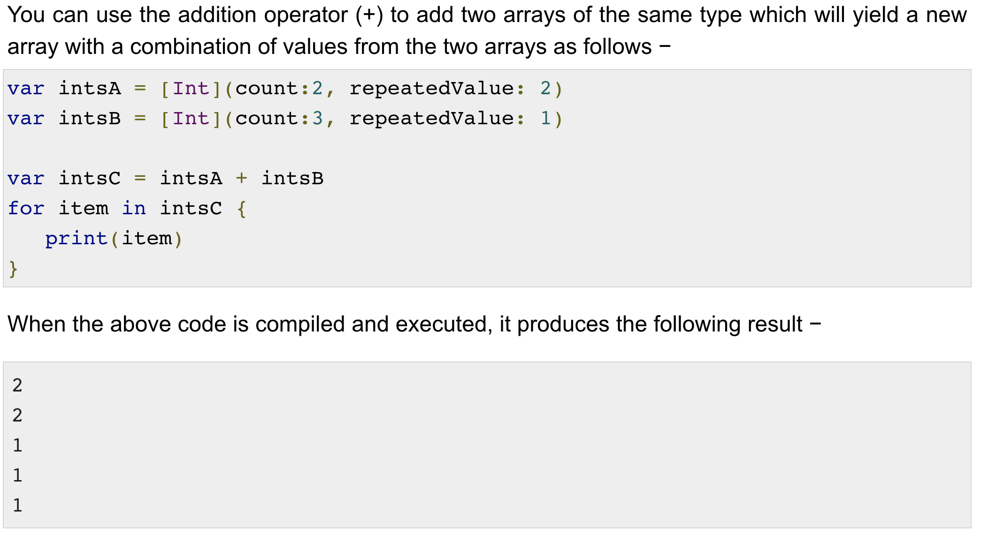
Adding Two Arrays

Slide 30
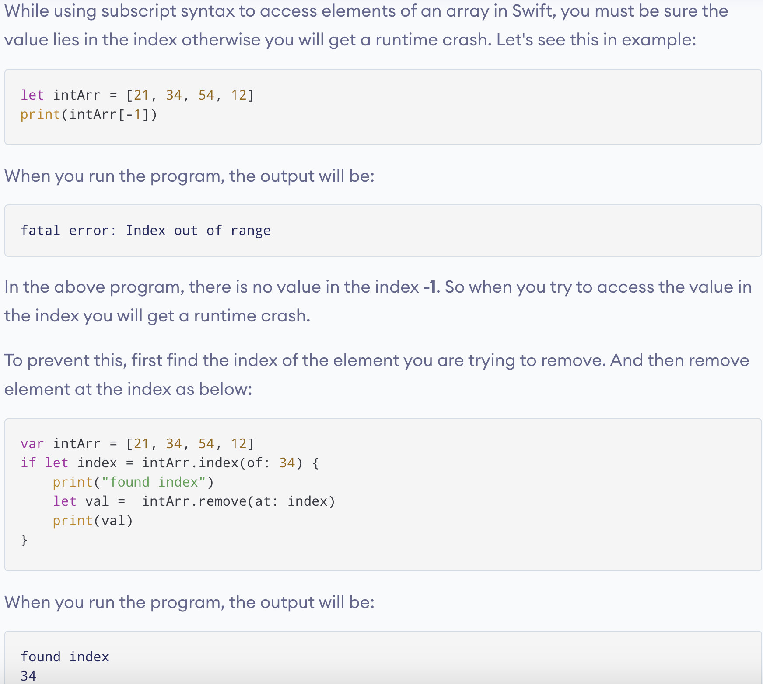
Things to Remember

